Slide 1

Chapter 1
Introduction
A note on the use of these ppt slides:
We’re making these slides freely available to all (faculty, students, readers). They’re in PowerPoint form so you can add, modify, and delete slides (including this one) and slide content to suit your needs. They obviously represent a lot of work on our part. In return for use, we only ask the following:
If you use these slides (e.g., in a class) in substantially unaltered form, that you mention their source (after all, we’d like people to use our book!)
If you post any slides in substantially unaltered form on a www site, that you note that they are adapted from (or perhaps identical to) our slides, and note our copyright of this material.
Thanks and enjoy! JFK/KWR
All material copyright 1996-2009
J.F Kurose and K.W. Ross, All Rights Reserved
Computer Networking: A Top Down Approach ,
3rd/5th edition.
Jim Kurose, Keith Ross
Pearson/Addison-Wesley, April 2009.
Introduction
1-<number>

Slide 2


Story So Far
Taxonomy of communication networks: Broadcast & connected
Types of communication mechanisms: Circuit-switched & Packet-switched
  Circuit-switched: reliable, guaranteed bandwidth but not scalable
  Packet-switched: unreliable, no bandwidth guarantees but scalable
Packet-switching preferred
  Datagram packet-switching : Internet! (large)
  Virtual-circuit Switching: QoS networks (small)

Slide 3

Story so far
Protocols (for Datagram packet switching)
  Definition of protocol
  Examples: HTTP, TCP, SMTP, IP
  Need for different protocols
    Communication protocols: making two end hosts understand each other
    Control protocols: enabling intermediate nodes to make decision on routing data
  Packet switching is best-effort
    Need additional mechanisms to handle problems
  Security mechanisms required for intentional errors

Slide 4
Story So far
Datagram packet switching
  No resource reservations for packets
  Path is determined using destination address found in packet headers
  Intermediate nodes maintain routing tables → prefix (aggregated list of destination addresses) to link maps
Main Issues to resolve (among others)!
  Reliability: packet loss, congestion control, & flow control → End host ↔ end host (e.g., TCP)
  Networking : building small networks → link ↔ link issue (e.g., Ethernet)
  Connectivity: linking smaller networks → network ↔ network (e.g., IP)
  Routing: finding paths among connected networks → packet switch ↔ packet switch (e.g., RIP, OSPF)

Slide 5
Today
Overview of Internet & Networking Technologies
Network Performance metrics

Slide 6
The Internet: End System and Network Core Views

Slide 7





What’s the Internet: “nuts and bolts” view
PC
millions of connected computing devices: hosts = end systems
  running network apps
Mobile network
server
Global ISP
wireless
laptop
cellular
handheld
Home network
communication links
  fiber, copper, radio, satellite
  transmission rate = bandwidth
Regional ISP
access
points
Institutional network
wired
links
routers: forward packets (chunks of data)
router
Introduction
1-<number>

Slide 8
What’s the Internet: “nuts and bolts” view
protocols control sending, receiving of msgs
  e.g., TCP, IP, HTTP, Skype, Ethernet
Internet: “network of networks”
  loosely hierarchical
  public Internet versus private intranet
Internet standards
  RFC: Request for comments
  IETF: Internet Engineering Task Force
Mobile network
Global ISP
Home network
Regional ISP
Institutional network
Introduction
1-<number>

Slide 9
What’s the Internet: a service view
communication infrastructure enables distributed applications:
  Web, VoIP, email, games, e-commerce, file sharing
communication services provided to apps:
  reliable data delivery from source to destination
  “best effort” (unreliable) data delivery
Introduction
1-<number>

Slide 10
A closer look at network structure:
network edge: applications and hosts
access networks, physical media: wired, wireless communication links
network core:
  interconnected routers
  network of networks
Introduction
1-<number>

Slide 11
The network edge:
end systems (hosts):
  run application programs
  e.g. Web, email
  at “edge of network”
peer-peer
client/server model
  client host requests, receives service from always-on server
  e.g. Web browser/server; email client/server
client/server
peer-peer model:
  minimal (or no) use of dedicated servers
  e.g. Skype, BitTorrent
Introduction
1-<number>

Slide 12
Access Networks

Slide 13
Access networks and physical media
Q: How to connect end systems to edge router?
residential access nets
institutional access networks (school, company)
mobile access networks
Keep in mind:
bandwidth (bits per second) of access network?
shared or dedicated?
Introduction
1-<number>

Slide 14
Dial-up Modem
central
office
telephone
network
Internet
home
PC
home
dial-up
modem
ISP
modem
(e.g., AOL)
Uses existing telephony infrastructure
  Home is connected to central office
up to 56Kbps direct access to router (often less)
Can’t surf and phone at same time: not “always on”

Slide 15

Digital Subscriber Line (DSL)
Existing phone line:
0-4KHz phone; 4-50KHz upstream data; 50KHz-1MHz downstream data
Internet
home
phone
DSLAM
telephone
network
splitter
DSL
modem
central
office
home
PC
  Also uses existing telephone infrastruture
  up to 1 Mbps upstream (today typically < 256 kbps)
  up to 8 Mbps downstream (today typically < 1 Mbps)
  dedicated physical line to telephone central office

Slide 16
Residential access: cable modems
Does not use telephone infrastructure
  Instead uses cable TV infrastructure
HFC: hybrid fiber coax
  asymmetric: up to 30Mbps downstream, 2 Mbps upstream
network of cable and fiber attaches homes to ISP router
  homes share access to router
  unlike DSL, which has dedicated access
Introduction
1-<number>

Slide 17
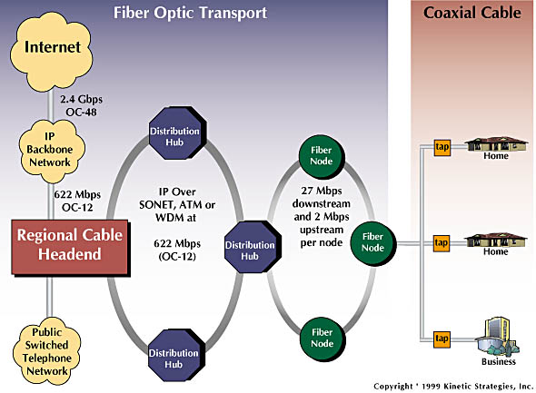
Residential access: cable modems
Diagram: http://www.cabledatacomnews.com/cmic/diagram.html
Introduction
1-<number>

Slide 18

Cable Network Architecture: Overview
Typically 500 to 5,000 homes
cable headend
cable distribution
network (simplified)
home
Introduction
1-<number>

Slide 19
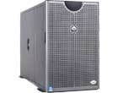
Cable Network Architecture: Overview
server(s)
cable headend
cable distribution
network
home
Introduction
1-<number>

Slide 20
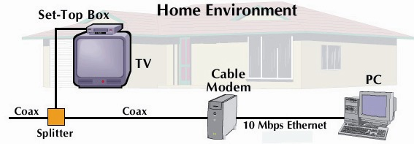
Cable Network Architecture: Overview
cable headend
cable distribution
network (simplified)
home
Introduction
1-<number>

Slide 21
Cable Network Architecture: Overview
FDM
C
O
N
T
R
O
L
V
I
D
E
O
V
I
D
E
O
V
I
D
E
O
V
I
D
E
O
V
I
D
E
O
V
I
D
E
O
D
A
T
A
D
A
T
A
1
2
3
4
5
6
7
8
9
Channels
cable headend
cable distribution
network
home
Introduction
1-<number>

Slide 22
Fiber to the Home
ONT
Internet
optical
fibers
optical
fiber
ONT
OLT
optical
splitter
central office
ONT
Optical links from central office to the home
Two competing optical technologies:
  Passive Optical network (PON) : smaller range
  Active Optical Network (PAN) : better inter-operability
Much higher Internet rates; fiber also carries television and phone services

Slide 23
Ethernet Internet access
100 Mbps
Institutional
router
Ethernet
switch
To Institution’s
ISP
100 Mbps
1 Gbps
100 Mbps
server
Typically used in companies, universities, etc
  10 Mbs, 100Mbps, 1Gbps, 10Gbps Ethernet
  Today, end systems typically connect into Ethernet switch

Slide 24
Wireless access networks
shared wireless access network connects end system to router
  via base station aka “access point”
wireless LANs:
  802.11b/g (WiFi): 11 or 54 Mbps
wider-area wireless access
  provided by telco operator
  ~1Mbps over cellular system (EVDO, HSDPA)
  WiMAX (10’s Mbps) over wide area
  USB modem based (3.1 Mbps)
router
base
station
mobile
hosts
Introduction
1-<number>

Slide 25
Home networks : Summary
Typical home network components:
DSL or cable modem
router/firewall/NAT
Ethernet
wireless access
point
wireless
laptops
to/from
cable
headend
cable
modem
router/
firewall
wireless
access
point
Ethernet
Introduction
1-<number>

Slide 26
Networking Technologies: Physical Media

Slide 27

Physical Media
Twisted Pair (TP)
two insulated copper wires
  Category 3: traditional phone wires, 10 Mbps Ethernet
  Category 5:
  100Mbps Ethernet
Bit: propagates between
transmitter/rcvr pairs
physical link: what lies between transmitter & receiver
guided media:
  signals propagate in solid media: copper, fiber, coax
unguided media:
  signals propagate freely, e.g., radio
Introduction
1-<number>

Slide 28


Physical Media: coax, fiber
Fiber optic cable:
glass fiber carrying light pulses, each pulse a bit
high-speed operation:
  high-speed point-to-point transmission (e.g., 10’s-100’s Gps)
low error rate: repeaters spaced far apart ; immune to electromagnetic noise
Coaxial cable:
two concentric copper conductors
bidirectional
baseband:
  single channel on cable
  legacy Ethernet
broadband:
  multiple channels on cable
  HFC
Introduction
1-<number>

Slide 29
Physical media: radio
signal carried in electromagnetic spectrum
no physical “wire”
bidirectional
propagation environment effects:
  reflection
  obstruction by objects
  interference
Radio link types:
terrestrial microwave
  e.g. up to 45 Mbps channels
LAN (e.g., Wifi)
  11Mbps, 54 Mbps
wide-area (e.g., cellular)
  3G cellular: ~ 1 Mbps
satellite
  Kbps to 45Mbps channel (or multiple smaller channels)
  270 msec end-end delay
  geosynchronous versus low altitude
Introduction
1-<number>

Slide 30
Structure of Internet

Slide 31
Internet structure: network of networks
roughly hierarchical
at center: “tier-1” ISPs (e.g., Verizon, Sprint, AT&T, Cable and Wireless), national/international coverage
  treat each other as equals
Tier-1 providers interconnect (peer) privately
Tier 1 ISP
Tier 1 ISP
Tier 1 ISP
Introduction
1-<number>

Slide 32
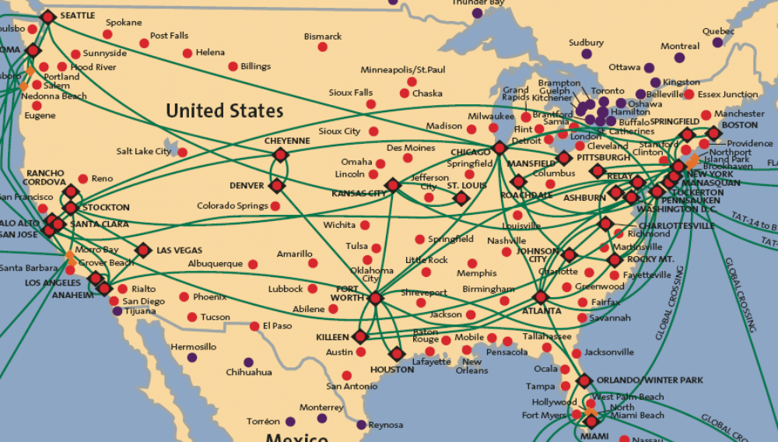
Tier-1 ISP: e.g., Sprint
POP: point-of-presence
to/from backbone
…
peering
….
…
…
…
to/from customers
Introduction
1-<number>

Slide 33
Internet structure: network of networks
“Tier-2” ISPs: smaller (often regional) ISPs
  Connect to one or more tier-1 ISPs, possibly other tier-2 ISPs
Tier-2 ISPs also peer privately with each other.
Tier-2 ISP pays tier-1 ISP for connectivity to rest of Internet
tier-2 ISP is customer of
tier-1 provider
Tier-2 ISP
Tier-2 ISP
Tier 1 ISP
Tier 1 ISP
Tier 1 ISP
Tier-2 ISP
Tier-2 ISP
Tier-2 ISP
Introduction
1-<number>

Slide 34
Internet structure: network of networks
“Tier-3” ISPs and local ISPs
  last hop (“access”) network (closest to end systems)
local
ISP
Tier 3
ISP
local
ISP
local
ISP
local
ISP
Local and tier- 3 ISPs are customers of
higher tier ISPs
connecting them to rest of Internet
Tier-2 ISP
Tier-2 ISP
Tier 1 ISP
Tier 1 ISP
Tier 1 ISP
Tier-2 ISP
Tier-2 ISP
Tier-2 ISP
local
ISP
local
ISP
local
ISP
local
ISP
Introduction
1-<number>

Slide 35
Internet structure: network of networks
a packet passes through many networks!
local
ISP
Tier 3
ISP
local
ISP
local
ISP
local
ISP
Tier-2 ISP
Tier-2 ISP
Tier 1 ISP
Tier 1 ISP
Tier 1 ISP
Tier-2 ISP
Tier-2 ISP
Tier-2 ISP
local
ISP
local
ISP
local
ISP
local
ISP
Introduction
1-<number>

Slide 36
Summary
Overview of Access Networks
Internet Topology Glimpse

Slide 37
Acknowledgment & Copyright
Acknowledgment: The instructor duly acknowledges the authors of the text book “Computer Networking: A Top-down approach”, James Kurose & Keith Ross and the instructors of EE122 “Computer Networks” course at UC Berkeley, Ian Stoica, Scott Shenker, Jennifer Rexford, Vern Paxson and other instructors at Princeton University for the course material.
Copyright: Certain modifications have been done to adapt the slides to the current audience and copyrighted by the instructor -Bruhadeshwar (Instructor) Computer Networks 2013 Spring (C)

